Slide 1
Ingrid Schulerud
Deputy Head of Mission and Ambassador to Belgium
Potsdam | BSSSC | 21.09.2017

Slide 2
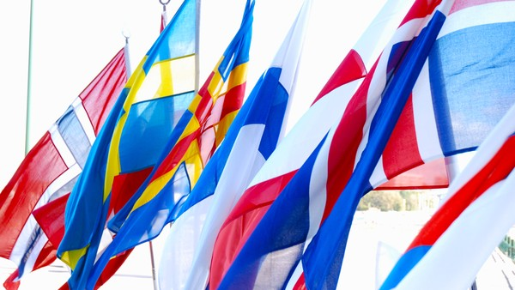
The Nordic Region in transition
The Nordic Region in Europe
The Nordic Region in the world

Slide 3
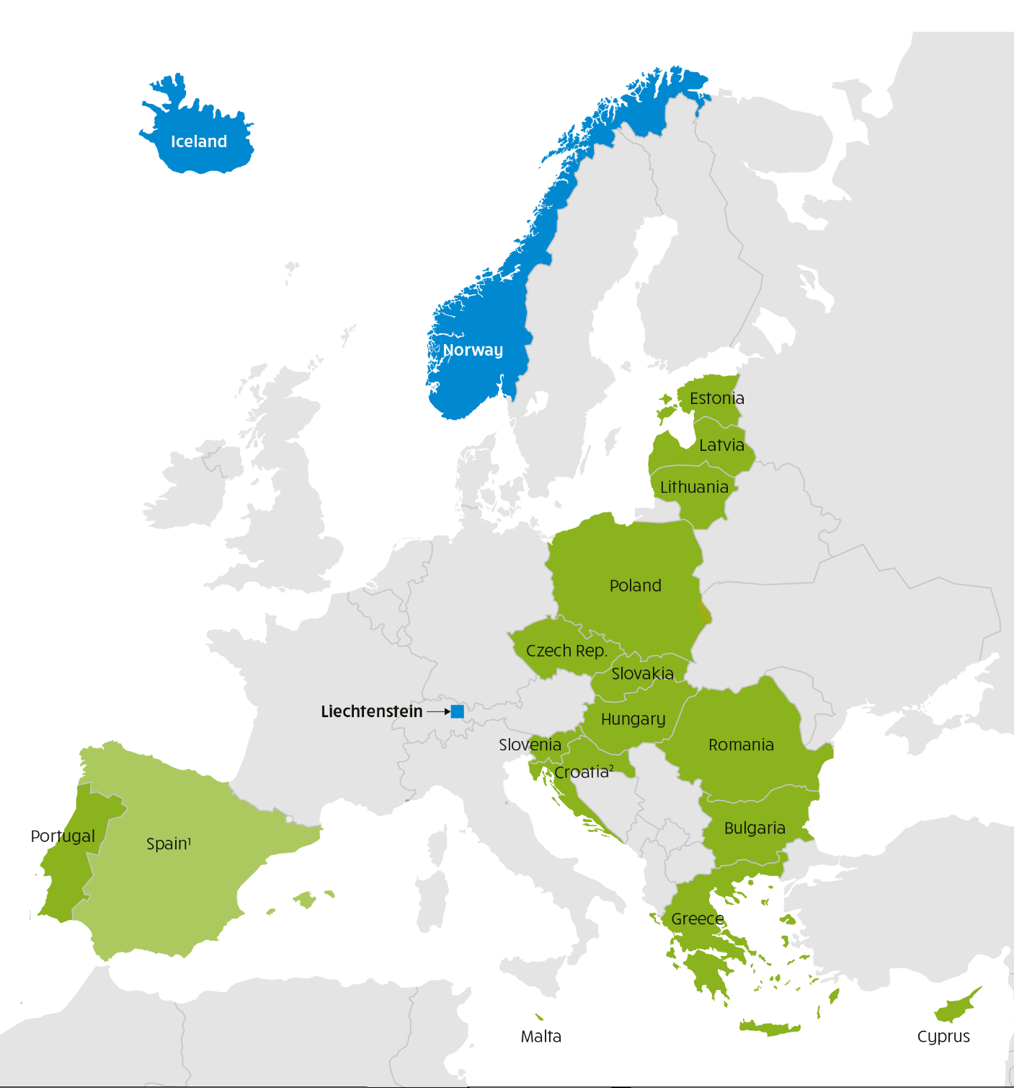
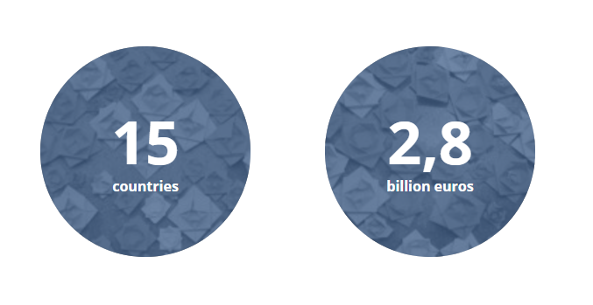

Slide 4
Europa Nostra

Slide 5
