Slide 1
Union of the Baltic Cities - HA Capacity - Brussels Antenna
Notes:
Cover slide, you can choose a version by clicking the right side of the mouse ->”Adjustment”.

Slide 2
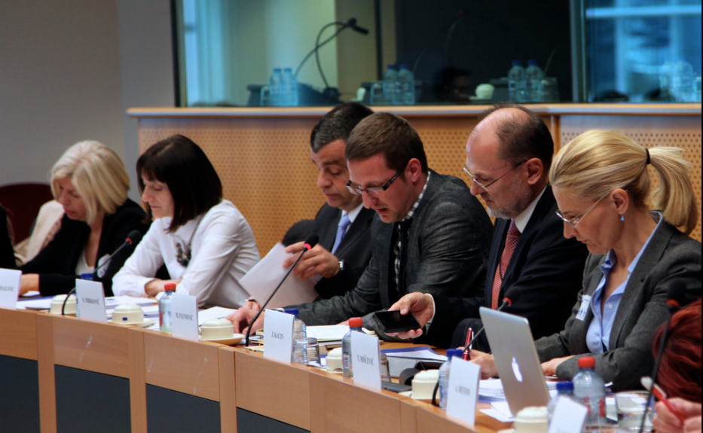
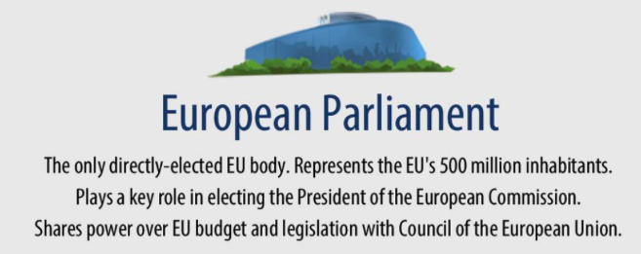
UBC EU Antenna

Slide 3
Roles:
Reinforce UBC role as a partner in European projects (Promoting UBC as a partner & kick off initiatives)
- Build synergies with member cities offices.
Straighten the visibility of UBC at the EU level
Facilitate institutional partnership with key EU stakeholders
Notes:
Add notes here.

Slide 4
Activities 2020:
Positioning Roadmap
European Week of Regions and Cities “Bridging citizens with SMART cooperation”
Task force for policy and projects
The event in the European Parliament postponed
Meetings with key stakeholders (tbc)
Notes:
Background picture can be changed by changing the background that will be under the entire slide, with the white area locked in the same position. You can choose a new slide from the upper menu -> New slide. The elements are locked to the basic slide view; if you wish to move the white border to right or left, copy the slide in the basic view.

Slide 5
New projects contribution increase % of UBC financing
UBC takes part in the most relevant EU policy dialogues
Better visibility at the EU level
=
Results
(by end of 2021.)
Notes:
Model page of how numerical information can be presented.

Slide 6
National Workshops
Notes:
Background picture can be changed by changing the background that will be under the entire slide, with the white area locked in the same position. You can choose a new slide from the upper menu -> New slide. The elements are locked to the basic slide view; if you wish to move the white border to right or left, copy the slide in the basic view.

Slide 7
The long-term viability of the EUSBSR is dependent upon active involvement of stakeholders.
New stakeholders: local and regional authorities, business, academia and civil society organizations;
Objective: strengthening the implementation of EUSBSR in the MS;
How? A campaign and workshops (7) gathering 280 new stakeholders;
Notes:
Background picture can be changed by changing the background that will be under the entire slide, with the white area locked in the same position. You can choose a new slide from the upper menu -> New slide. The elements are locked to the basic slide view; if you wish to move the white border to right or left, copy the slide in the basic view.

Slide 8
National Workshops
Seven online workshops in Denmark, Germany, Poland, Lithuania, Latvia, Estonia and Finland.
The objectives:
Promoting stakeholders and their involvement in each country;
Increasing the level of knowledge of macro-regional strategies;
Introducing concrete benefits for the stakeholders;
Brainstorming and suggesting potential follow-up actions within EUSBSR;
Expected results:
3.1. The visibility of EUSBSR is increased in member states;
3.2. The support for shaping the national implementation of the strategy is increased within the pool of new stakeholders;
3.3. The higher commitment of new stakeholders to integrate the strategy in their strategic decisions or initiatives;

Slide 9
unionofthebalticcities
Join us!
For a greater involvement of UBC cities in the EU Policy building.
Notes:
Model page of how some important messages can be highlighted.

Slide 10
THANK YOU!
www.ubc.net
Secretariat of the Union of the Baltic Cities
Wały Jagiellońskie 1, 80-853 Gdańsk, Poland Tel. + 48 58 3010917, + 48 58 3019123
Notes:
On the last thank you -page there is a ubc.net address ready + room for your own contact details. Background can be changed by clicking the right side of the mouse -> edit background.

